Slide 1
Introduction to SQL - Retrieval
CSE
Department of
Computer
Science
&
Engineering
Database Management System

Slide 2
Example
Query: What is the average standard price for all products in inventory?
SELECT AVG (ProductStandardPrice) AS AveragePrice FROM Product_T;
Result:
AVERAGEPRICE
440.625
Query: How many different items were ordered on order number 1004?
SELECT COUNT (*) FROM OrderLine_T WHERE OrderID = 1004;
Result:
COUNT (*)
2

Slide 3
Examples
Query: Alphabetically, what is the first product name in the Product table?
SELECT MIN (ProductDescription)
FROM Product_T;

Slide 4
Comparison Operators
Operator Meaning
= Equal to
> Greater than
>= Greater than or equal to
< Less than
<= Less than or equal to
<> Not equal to
!= Not equal to

Slide 5
Example
Query: Which orders have been placed since 10/24/2010?
SELECT OrderID, OrderDate
FROM Order_T
WHERE OrderDate > ‘24-OCT-2010’;
Query: What furniture does Pine Valley carry that isn’t made of cherry?
SELECT ProductDescription, ProductFinish
FROM Product_T
WHERE ProductFinish != ‘Cherry’;

Slide 6
Boolean Operators
AND: Joins two or more conditions and returns results only when all conditions are true.
OR: Joins two or more conditions and returns results when any conditions are true.
NOT: Negates an expression.
Priority order of Boolean operator is AND, OR and NOT

Slide 7
Example
Query A: List product description, finish, and standard price for all desks and all tables that cost more than $300 in the Product table.
SELECT ProductDescription, ProductFinish, ProductStandardPrice
FROM Product_T
WHERE ProductDescription LIKE ‘%Desk’
OR ProductDescription LIKE ‘%Table’
AND ProductStandardPrice > 300;

Slide 8
Ranges for Qualification
Query: Which products in the Product table have a standard price between $200 and $300?
SELECT ProductDescription, ProductStandardPrice
FROM Product_T
WHERE ProductStandardPrice > 199 AND ProductStandardPrice < 301;
OR
SELECT ProductDescription, ProductStandardPrice
FROM Product_T
WHERE ProductStandardPrice BETWEEN 200 AND 300;

Slide 9
IN and NOT IN with Lists
Query: List all customers who live in warmer states.
SELECT CustomerName, CustomerCity, CustomerState
FROM Customer_T
WHERE CustomerState IN (‘FL’, ‘TX’, ‘CA’, ‘HI’);
Query: List all customers who do not live in warmer states.
SELECT CustomerName, CustomerCity, CustomerState
FROM Customer_T
WHERE CustomerState NOT IN (‘FL’, ‘TX’, ‘CA’, ‘HI’);

Slide 10
Sorting Results: The ORDER BY Clause
Query: List customer, city, and state for all customers in the Customer table. List the customers alphabetically by state and alphabetically by customer within each state.
SELECT CustomerName, CustomerCity, CustomerState
FROM Customer_T
ORDER BY CustomerState, CustomerName;

Slide 11
Categorizing Results: The GROUP BY Clause
GROUP BY is particularly useful when paired with aggregate functions, such as SUM or COUNT. GROUP BY divides a table into subsets (by groups); then an aggregate function can be used to provide summary information for that group.
Scalar aggregate: A single value returned from an SQL query that includes an aggregate function.
Vector aggregate: Multiple values returned from an SQL query that includes an aggregate function.

Slide 12
Example
Query: Count the number of customers with addresses in each state to which we ship.
SELECT CustomerState, COUNT (CustomerState)
FROM Customer_T
GROUP BY CustomerState;
Query: Count the number of customers with addresses in each city to which weship. List the cities by state.
SELECT CustomerState, CustomerCity, COUNT (CustomerCity)
FROM Customer_T
GROUP BY CustomerState, CustomerCity;

Slide 13
GROUP BY
SELECT COUNT(CustomerID), Country
FROM Customers
GROUP BY Country;

Slide 14
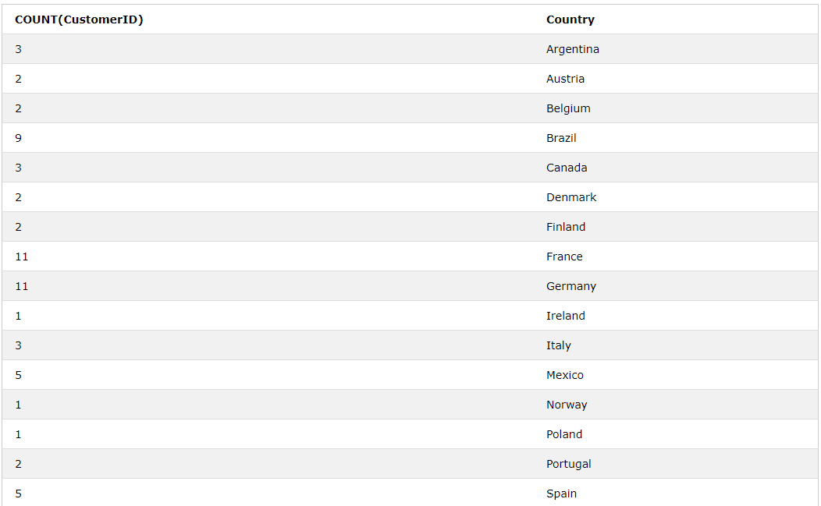

Slide 15
The HAVING Clause
Query: Find only states with more than one customer.
SELECT CustomerState, COUNT (CustomerState)
FROM Customer_T
GROUP BY CustomerState
HAVING COUNT (CustomerState) > 1;
Query: List, in alphabetical order, the product finish and the average standard price for each finish for selected finishes having an average standard price less than 750.
SELECT ProductFinish, AVG (ProductStandardPrice)
FROM Product_T
WHERE ProductFinish IN (‘Cherry’, ‘Natural Ash’, ‘Natural Maple’, ‘White Ash’)
GROUP BY ProductFinish
HAVING AVG (ProductStandardPrice) < 750
ORDER BY ProductFinish;

Slide 16
Thank You

